Slide 1
NE 591: Advanced Reactor Materials
Fall 2021
Dr. Benjamin Beeler

Slide 2
Last Time
Thermal conductivity degradation
fission gas swelling/porosity, sodium infiltration
Fuel-cladding mechanical interaction
fuel swelling, creep, internal pressure, etc.
Fuel-cladding chemical interaction
phase diagrams and kinetics, low melting points, intermetallics, etc.

Slide 3
Reprocessing
Pyroprocessing
For more than 50 years, pyrometallurgy has been studied as an alternative strategy in the reprocessing of used fuel
Pyrochemical processes rely on refining techniques at high temperature (500–900 C) depending on the molten salt eutectic used
Typically, chloride systems operate at lower temperature compared to fluoride systems, and are preferred in processing
These processes are mainly based on electrorefining or on extraction from the molten salt phase into liquid metal
Two processes-one for oxide fuel and one for metallic fuel-have been developed to near industrial scale

Slide 4
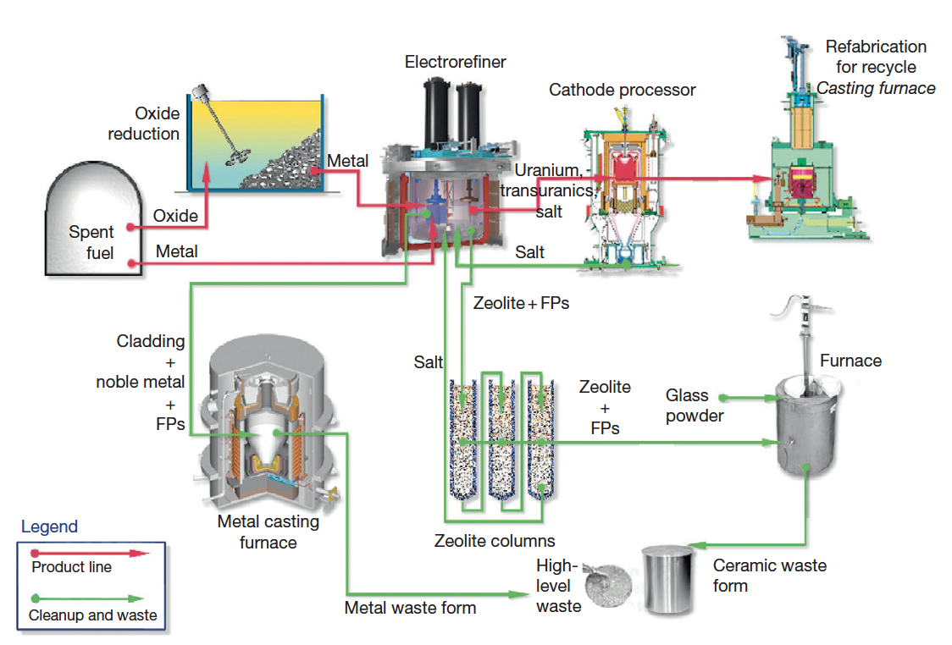
IFR Pyroprocess
This process was developed in the US to be part of the IFR project, and can handle the treatment of transuranics
The fuel is recycled using an electrochemical process based on molten chloride salts and liquid metals
The molten salt medium for electrorefining is a solution of a certain amount of UCl3 dissolved in a LiCl–KCl eutectic

Slide 5
IFR Pyroprocess
The fuel is electrochemically dissolved using a potential between the basket (loaded with used fuel) as anode and a stainless steel electrode in the salt as the cathode
Uranium and TRU are deposited on the anodes
Once the fuel is dissolved and most of the uranium is deposited on the solid steel, this cathode is replaced by a liquid cadmium cathode, and the remaining TRUs can be codeposited with the remaining uranium

Slide 6
IFR Pyroprocess
The alkali, alkaline earth, rare earth, and halide FPs remain primarily dissolved in the salt phase
More than 90% of the noble metal FPs and fuel alloy material are retained in the chopped fuel cladding segments in the anode baskets
Can reduce the repository burden of radioactive waste by separating long-lived MA from spent light-water reactor fuel, burning MA in fast reactors, and decreasing the long-term radioactivity of nuclear waste

Slide 7
Refabrication
Metal-fueled fast reactors facilitate the effective transmutation of MA because of the high-energy neutron spectrum
One of the measures to load MA into the reactor core is to add MA to the fuel alloy homogeneously
Can perform injection casting in the same manner as the fresh fuel, to form MA-bearing fuel alloys
These technologies are expected to reduce the fuel cycle cost even for small-scale fuel cycle plants because of the simplicity of the process and the compactness of the equipment
For example, in the injection casting process, composition adjustment, melting (alloying), and casting of the fuel slug can be done in a single injection-casting furnace

Slide 8
Metallic fuel performance modeling

Slide 9
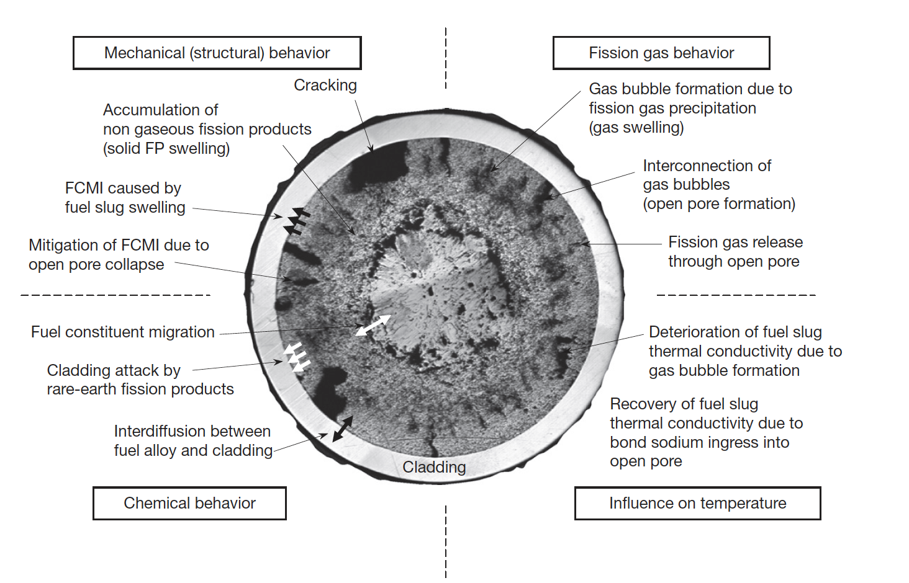
Metallic Fuel Phenomena

Slide 10
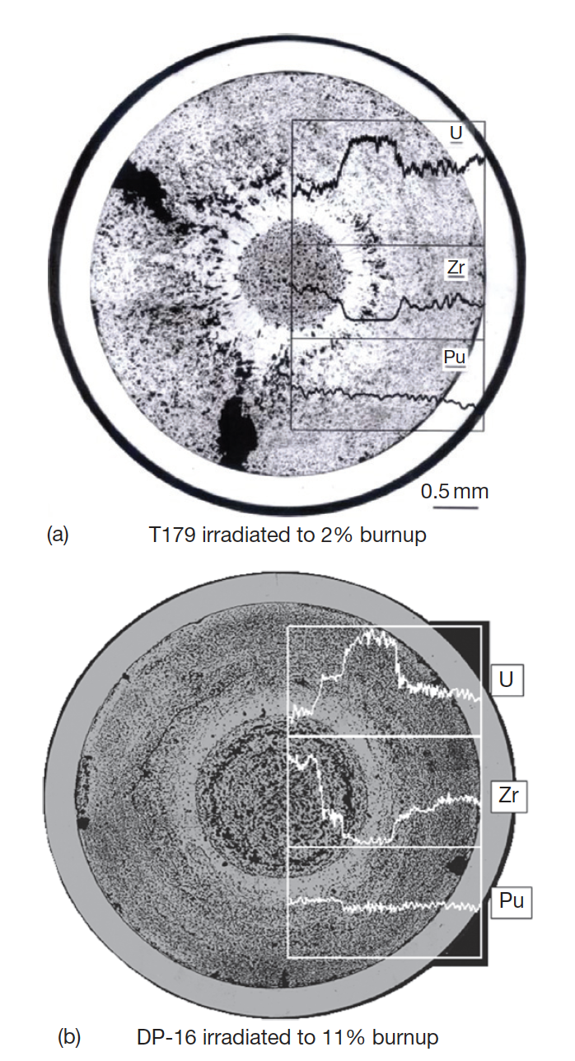
Constituent Redistribution Models
Constituent redistribution is driven by:
temperature gradients in the fuel,
solubility gradients in a phase and phase boundaries,
additional chemical potentials applied by fuel– cladding gap and cladding
Results in three concentric zones, namely, a Zr-enriched central zone, a Zr-depleted and U-enriched intermediate zone, and a slightly Zr-enriched zone on the outer periphery
Migration quickly levels off early in life after a new distribution settles

Slide 11
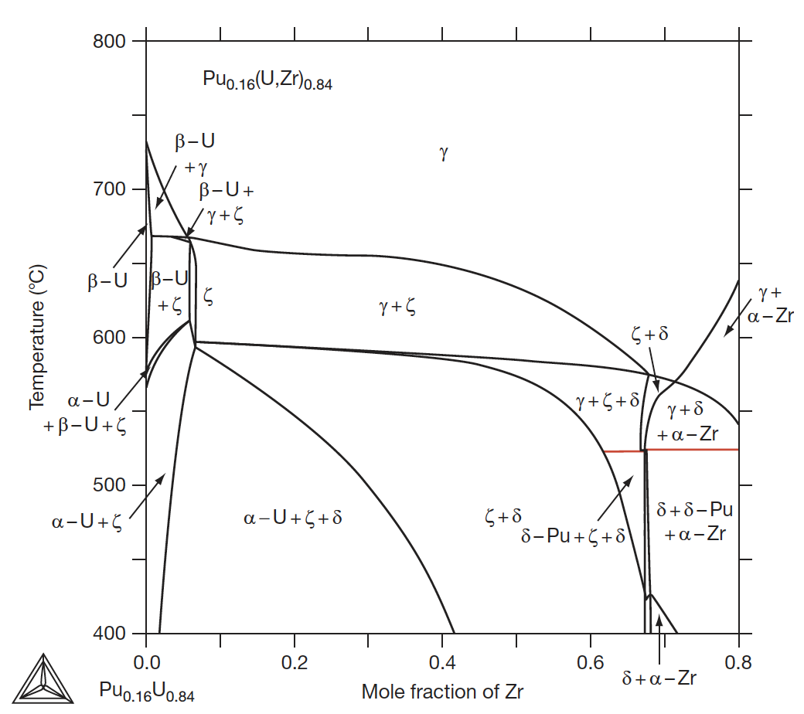
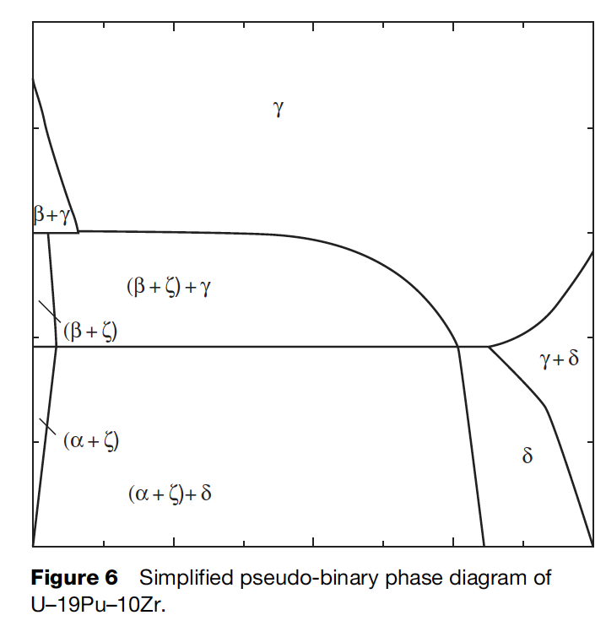
Constituent Redistribution Models
While ternary phase diagrams exist, their accuracy is suspect, and simplified pseudo-binary phase diagrams can be more easily implemented, and removes complexities associated with largely unknown phases
When applied to a fuel with different Pu content, the phase diagram must be modified accordingly

Slide 12
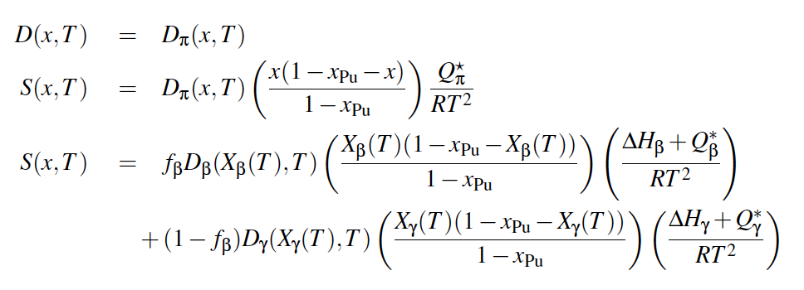
Constituent Redistribution Models
Using the calculated phase fractions, the Fickian and Soret diffusion coefficient are determined
Artificial factors are used to set the diffusivity in two-phase regions and to scale diffusivities in each phase
The magnitudes of diffusivities in each phase are largely unknown, and effectively wholly unknown in two-phase regions
BISON Zr Diffusion Model

Slide 13
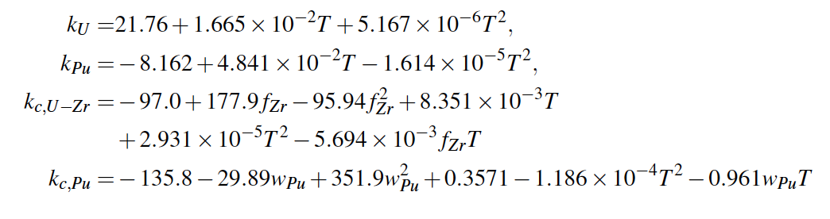
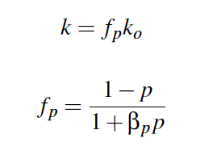
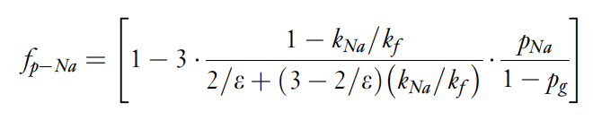
Temperature Predictions
Constituent redistribution relies on accurate temperature profiles
Fuel temperature is affected by the thermal conductivity of the fuel, which in turn is changed by porosity evolution and sodium infiltration, in addition to changes in Zr concentration
BISON thermal conductivity models exist for the distinct phases/species, and account for degradation of thermal conductivity

Slide 14
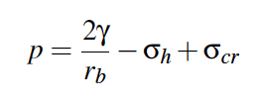
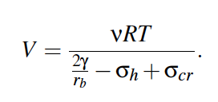
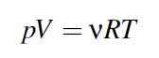
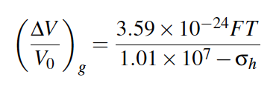
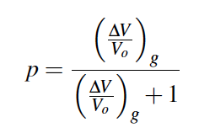
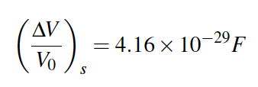
Porosity Predictions
BISON utilizes a simplified model for porosity
The mechanical force balance on an equilibrium bubble can be expressed by the Young-Laplace equation
Making assumptions for creep stress, bubble size, can calculation swelling due to fission gas
Finally, can determine porosity from the swelling
Solid fission products are a function of fission density

Slide 15
Porosity Predictions
These porosity models don’t incorporate different phases, initial porosity, axial/radial swelling, etc.
These models have been updated slightly to improve code robustness, but still don’t incorporate these critical microstructural phenomena

Slide 16
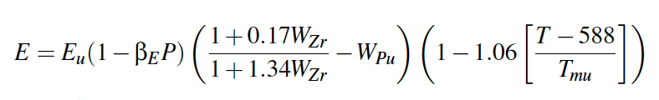
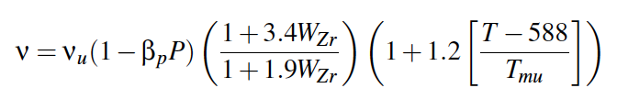
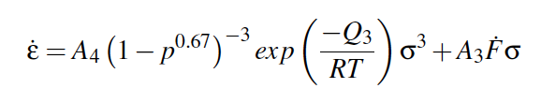
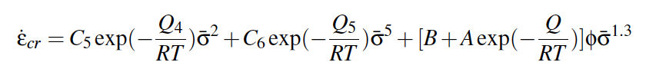
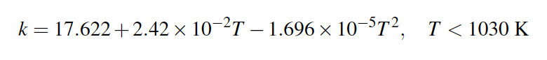
Mechanical Properties
Young’s Modulus
Poisson’s ratio
Creep
Cladding models for HT-9 creep and k_{th}

Slide 17
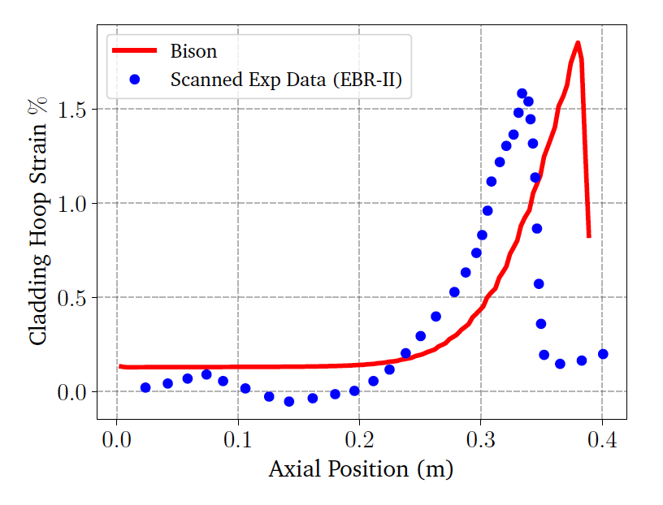
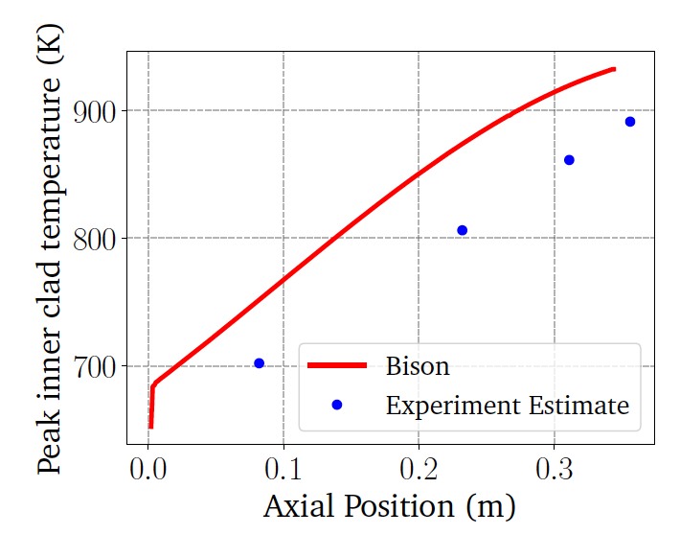
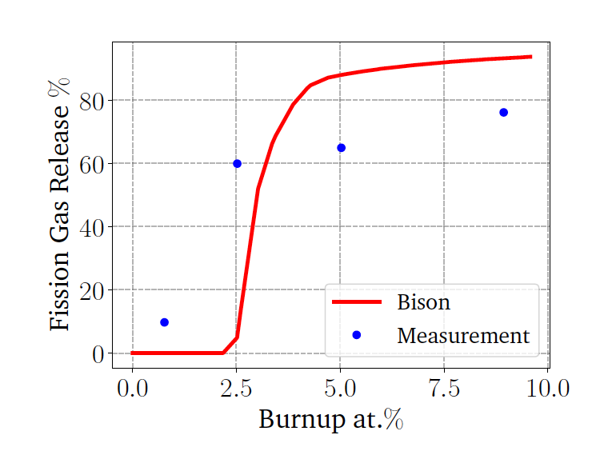
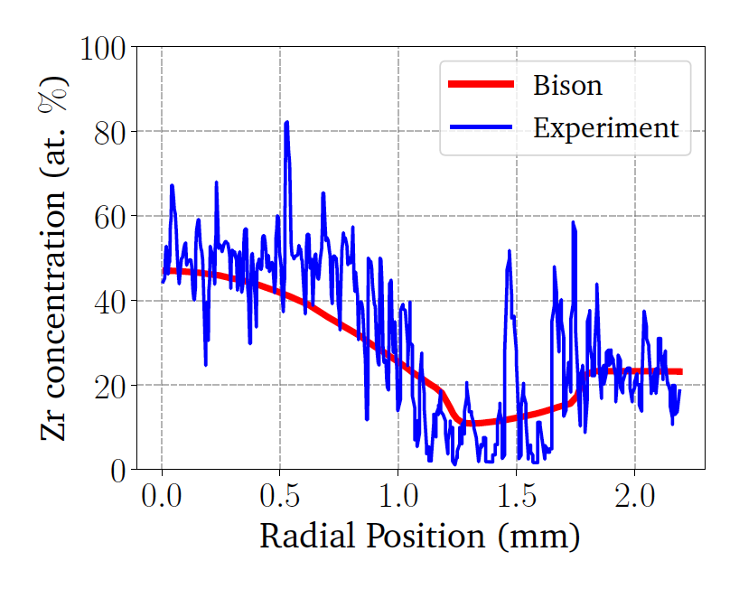
BISON Testing
BISON can handle binary and ternary fuel and compare reasonably well with EBR-II data
Discrepancies are due to inadequate knowledge of materials models, and underlying issues with material descriptions, and code robustness
Development is ongoing, and improvements to swelling models, for example, have been made

Slide 18
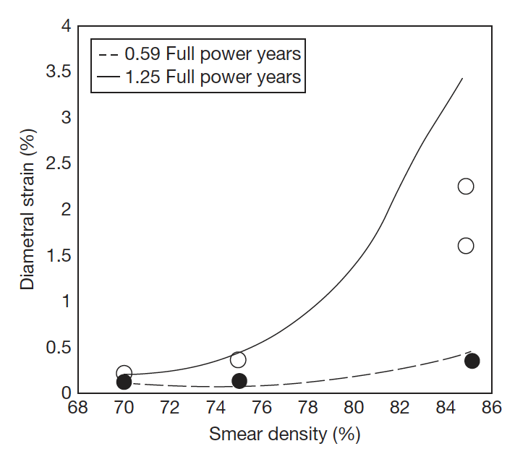
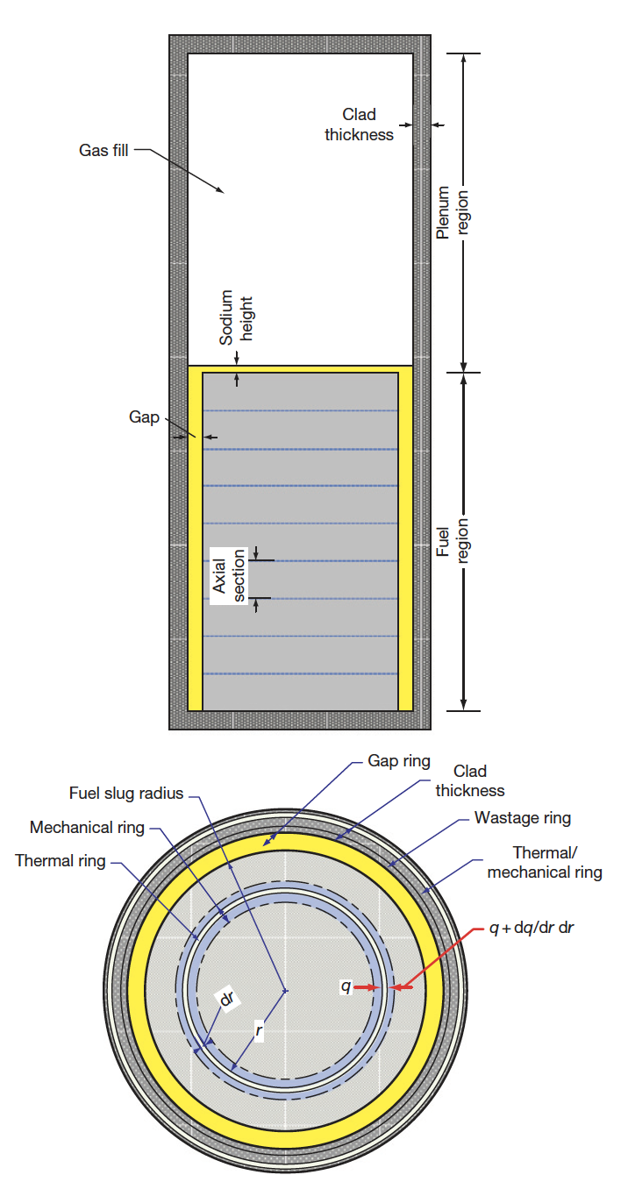
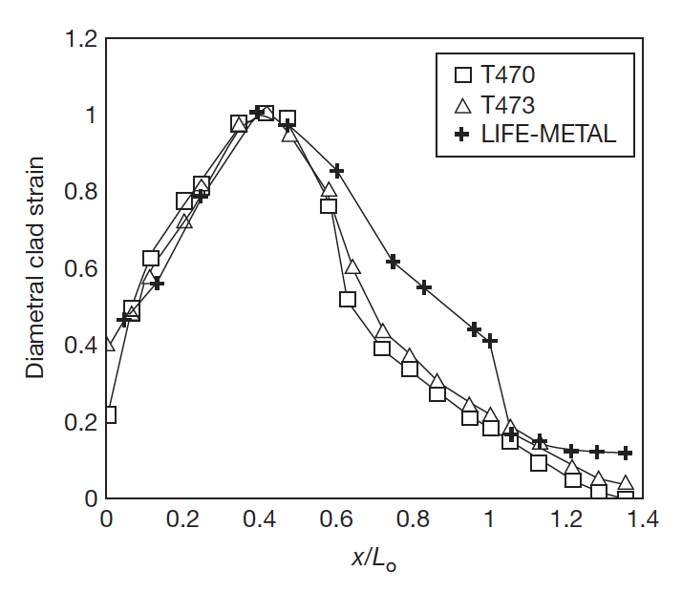
Other Codes
LIFEMETAL
The code has evolved from the LIFE series of codes from ANL that perform steady-state and transient analyses for nuclear fuel
The original code was developed for UO2 and mixed oxide fuels for use in fast reactor systems
The code was developed in association with the IFR and has been extensively used for planning steady state and transient experiments at EBR-II

Slide 19
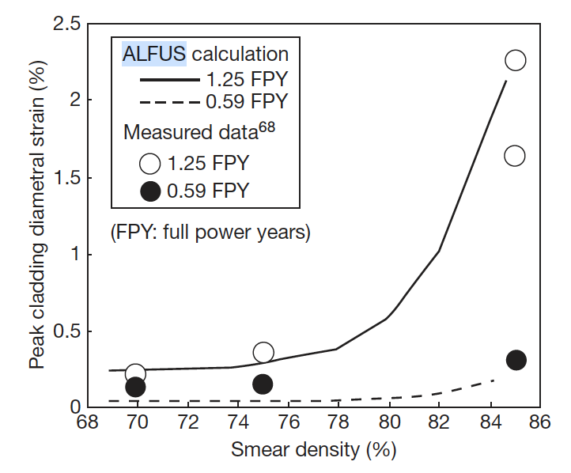
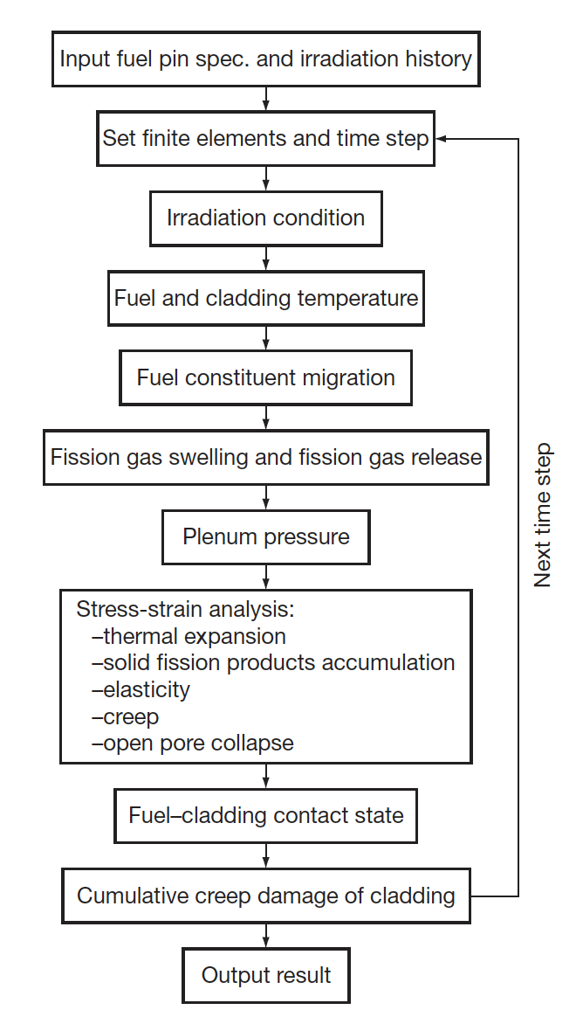
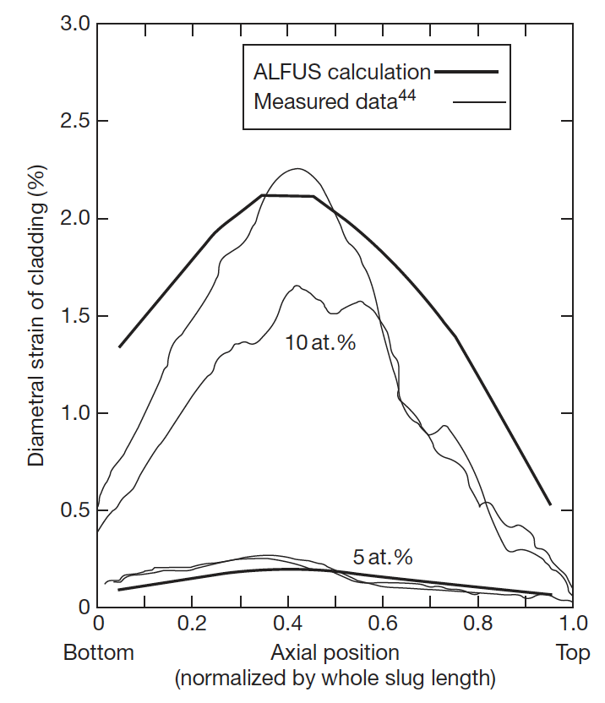
Other Codes
ALFUS
JAEA code that is multiphysics in nature and focuses on the mechanical behavior of the fuel under irradiation
Both LIFE-METAL and ALFUS are capable of simulating metal fuel irradiation behavior to some extent
Both lack different swelling in different radial zone, coupling of redistribution, realistic predictions of FCCI

Slide 20
Mixed oxide fuel

Slide 21
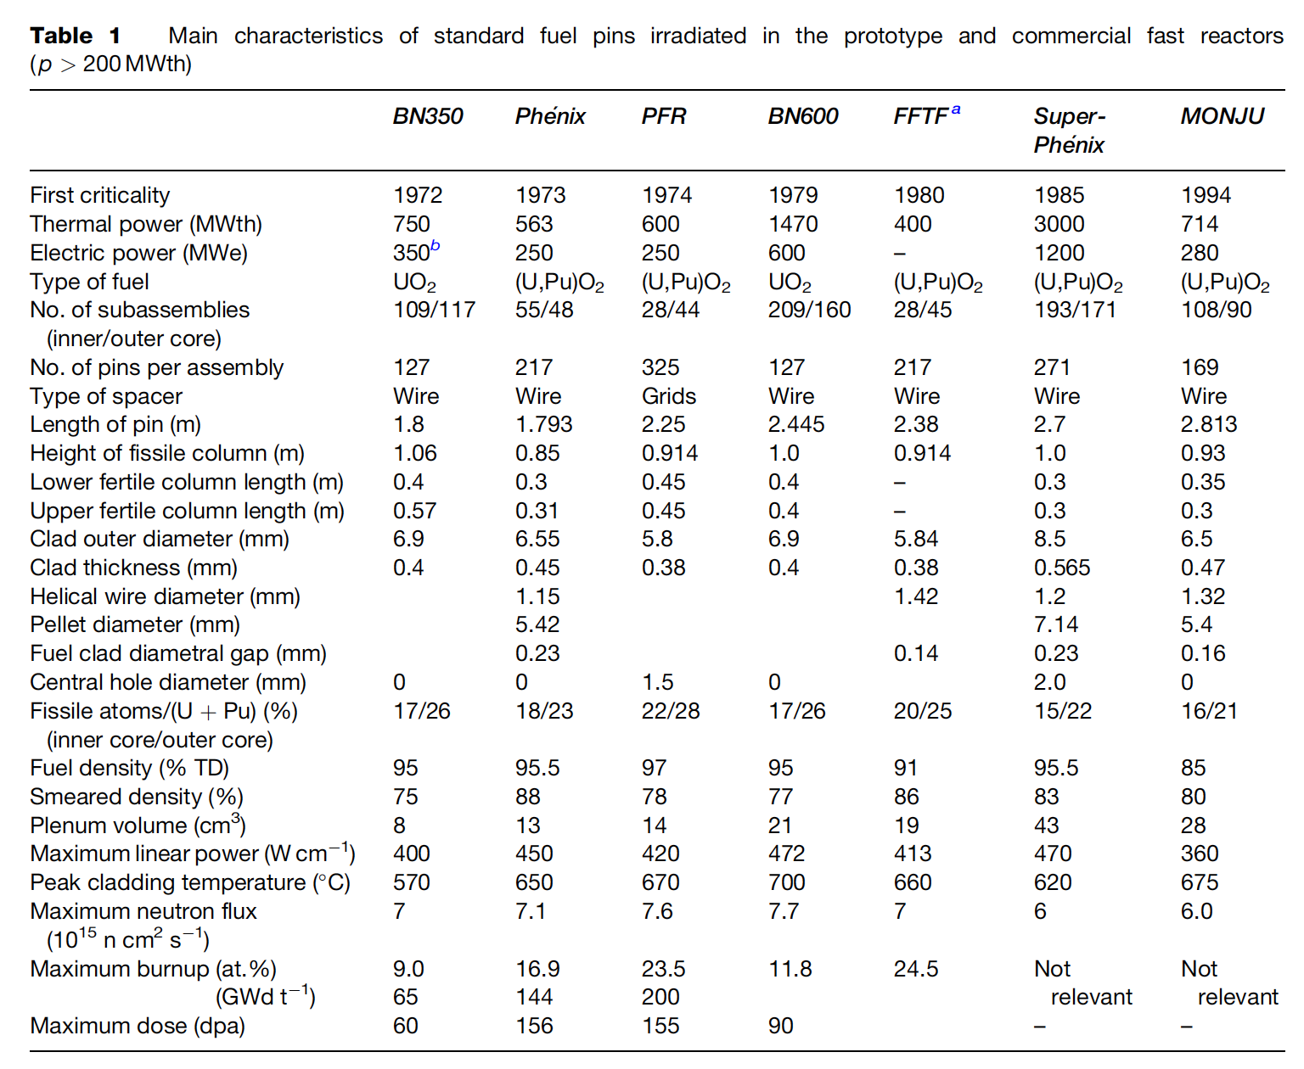
MOX Introduction
Despite some disadvantages, such as its low U density, poor thermal conductivity, and its chemical reaction with sodium, MOX fuel (U,Pu)O2 is the fuel that has been used most in fast reactors
In order to avoid the dramatic swelling of metallic fuels, MOX fuels were explored in fast reactors
Behavior was observed to be satisfactory and was relatively widely implemented in SFRs

Slide 22
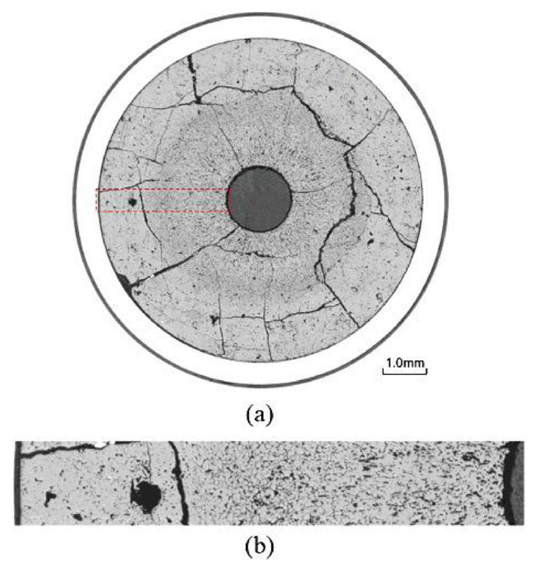
MOX Fuels in SFRs
SRFs with MOX fuel will lead the MOX to run at higher temperatures than LWR fuel, and thus with different properties
Fission product phases and evolving microstructures create highly localized properties that can differ significantly from the bulk fuel
Stoichiometry and Pu content are important factors that dictate thermal properties

Slide 23
MOX Restructuring
Oxide nuclear fuels are commonly touted for their outstanding high temperature capabilities under irradiation, but this stability comes the tradeoff of low thermal conductivity
Due to the low thermal transport, a steep temperature gradient is formed along the radius of the fuel pellet, with the hottest region at the center of the pellet and coolest near the cladding
This leads to grain growth and restructuring
Pu bearing fast reactor oxide fuels display four defining regions of a restructured pellet:
the central void, the columnar grain growth region, the equiaxed grain growth region, and the as-sintered region
The higher temperatures and heating rates form coarse, elongated grains that grow radially toward the outer rim of the fuel

Slide 24
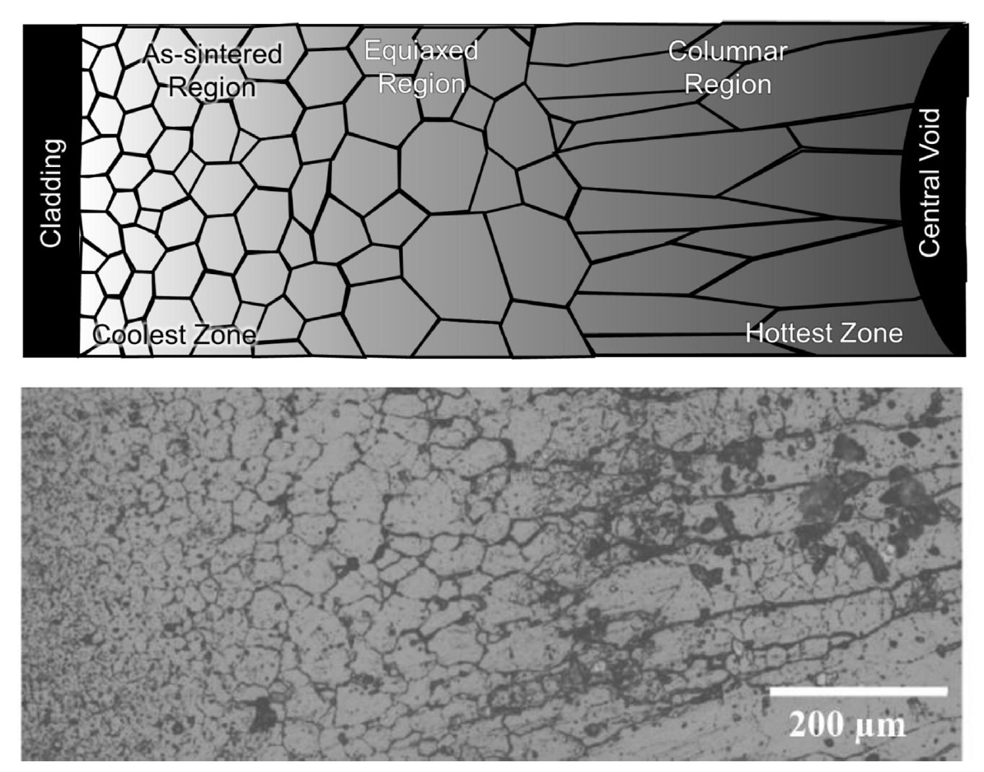
MOX Restructuring
The equiaxed region consists of grains that have undergone significant growth when compared to the un-irradiated samples
Central voids have been shown to appear in irradiation times as short as 10 min, demonstrating that the appearance the central void is a result of fuel temperature and linear heating rate, not high burnup
The central void forms from the accumulation of voids and pores present in the fuel along a thermal gradient

Slide 25
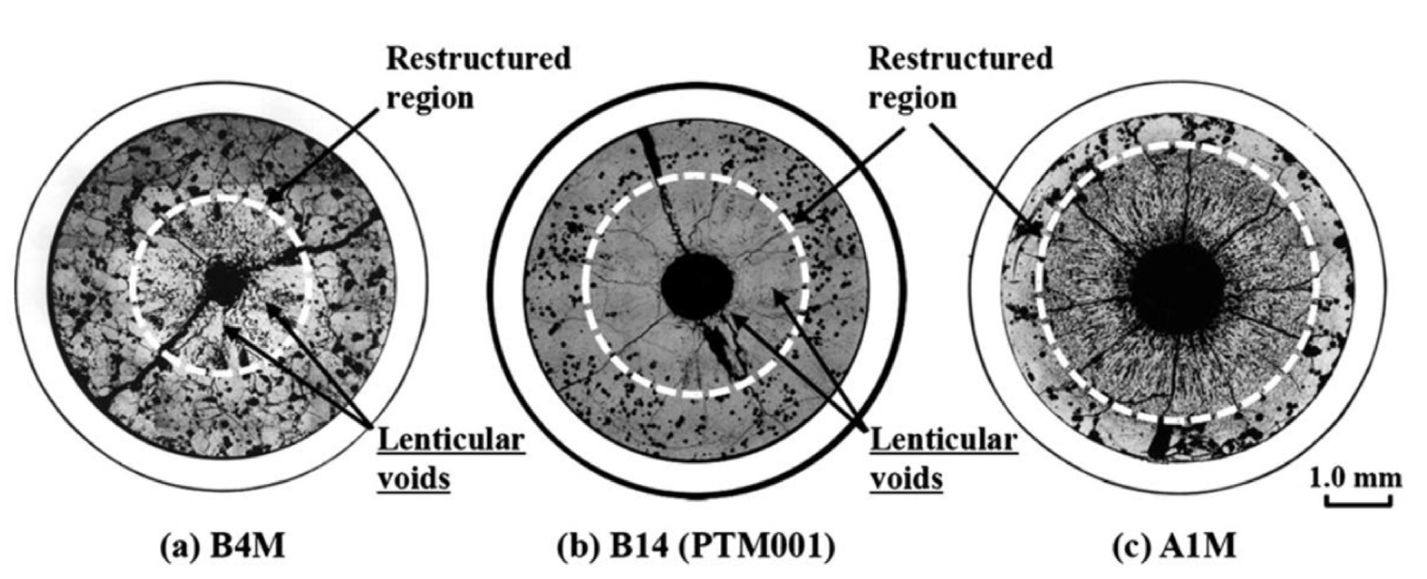
MOX Pore Formation
Heating Rate

Slide 26
MOX Pore Formation
The smallest spherical pores are highly mobile, being able to quickly and easily move through the restructured region
Intermediate sized pores become flat and elongated as they travel towards the fuel centers, leaving streaks at the tips of the voids as they travel
These “lenticular” voids are the most readily identifiable porosity feature in the irradiated MOX fuels due to their distinct shape

Slide 27
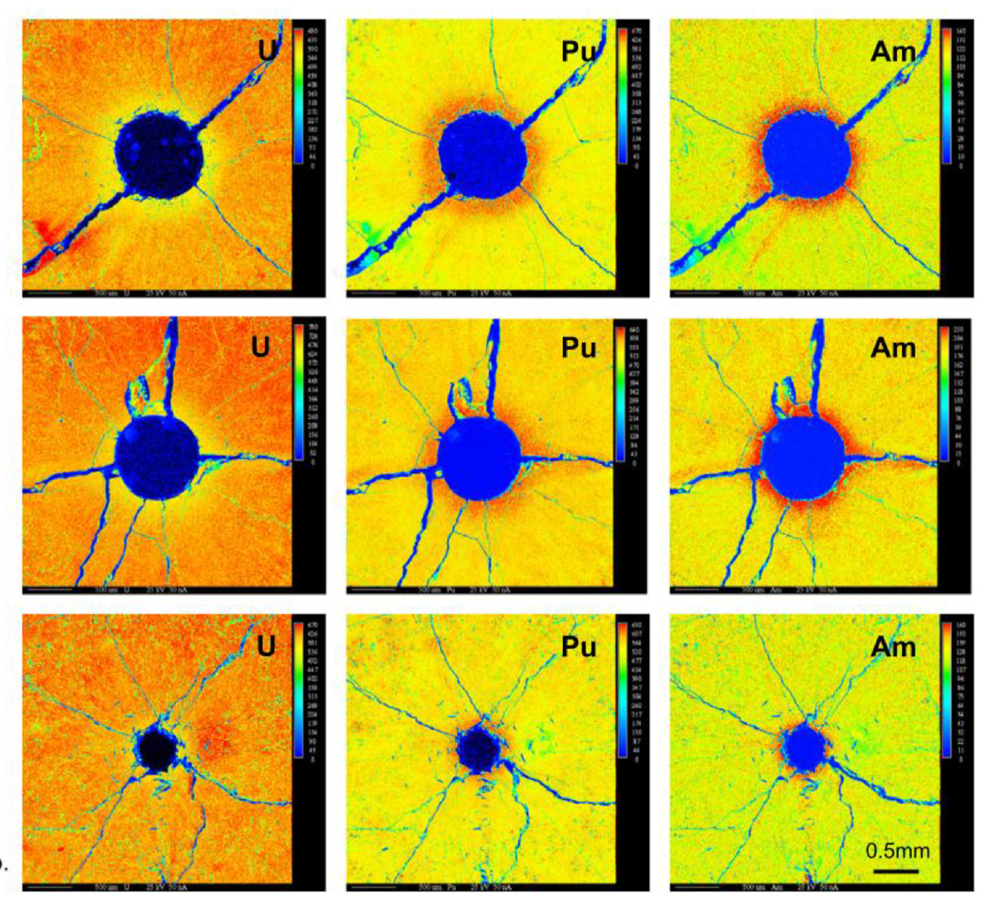
Redistribution of Pu
The movement of pores leads to a redistribution of plutonium, resulting in a spike in Pu concentration surrounding the central void
Similar behavior has been observed for americium
This transuranic concentration increase is accompanied with a decrease in U concentration
This redistribution increases the local fission rate and centerline temperature, while generating lower melting point phases

Slide 28
Redistribution of Pu
This phenomenon is currently understood as an evaporation-condensation process
The fuel at the edge of the pore closest to the centerline becomes gaseous inside the pore and deposits itself on the cooler region of the pore closest to the cladding
UO2 is the more volatile of the U/Pu heavy metal species present in the fuel matrix
The high oxygen potential can lead to a high partial pressure of UO3 within the self-contained pores
Enriched regions of PuO2 are left behind and deposited at the leading edge of the central void as the porosity agglomerates in the fuel center
Some experiments on O/M ratio seems to point towards higher O potential leading to more redistribution
While this is the working theory, it is not clear if this explanation can also account for the necessary pore velocities
No experimentally proven substitution has been put forth as a replacement theory to the observed features

Slide 29
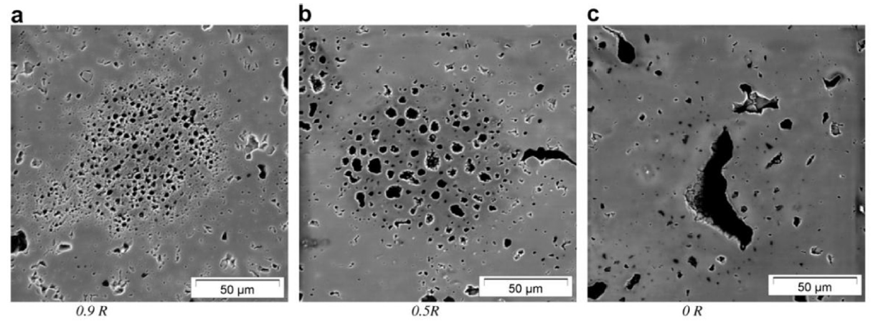
Pu-rich Agglomerates
Regions of high Pu concentration form in the MOX fuel matrix due to incomplete mixing during fabrication
Clusters of dispersed porosity form in the high Pu concentration regions because of the different fission rate
PA's are highly dense in fissile material, with the high Pu content leading to heating rates and burnups beyond the low concentration UO2 matrix material
Thermal conductivity of the spots is also lower than the surrounding matrix, thus the agglomerates are simultaneously hotter and undergo a greater number of fission events in a very small region
Burnup in these regions may be greater than 2-3 times that of the pellet as a whole

Slide 30
Pu-rich Agglomerates
The morphology of porosity in the agglomerates depends on the temperature
Toward the outer, relatively cool section of the fuel, porosity forms a large number of small bubbles, only 1-2 μm in diameter
In the intermediate radius of the pellet the densely populated, small pores start to agglomerate to form larger pores
Near the hot center of the fuel, the bubbles now reach sizes upwards of 50 μm with only a few isolated pores remaining
Porosity formed due to PA's are visually distinct from those caused by fission gas accumulation on grain boundaries and porosity formed during pellet sintering

Slide 31
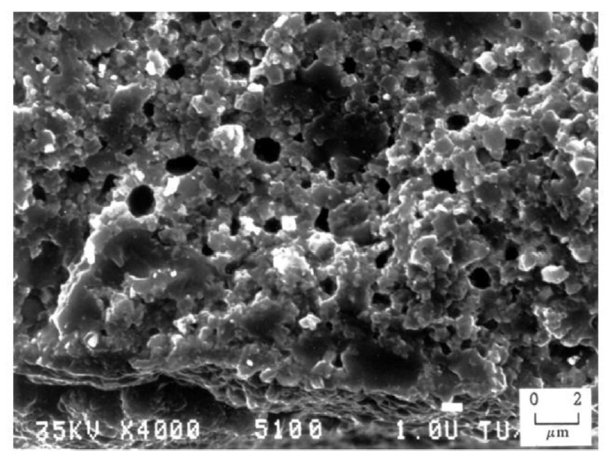
Pu-rich Agglomerates
The presence of the high burnup structure (HBS) has been observed within the PA regions
The HBS is basically a fine grained, cauliflower-like structure
In MOX fuels, the HBS structure appears in fuels following burnups between 60 and 80 GWd/tM at temperatures below approximately 1100C
PA's reach these local burnups at pellet burnups far below this threshold

Slide 32
Summary
Pyroprocessing
Metallic fuel performance modeling
MOX intro

Slide 33
Questions?

Slide 34
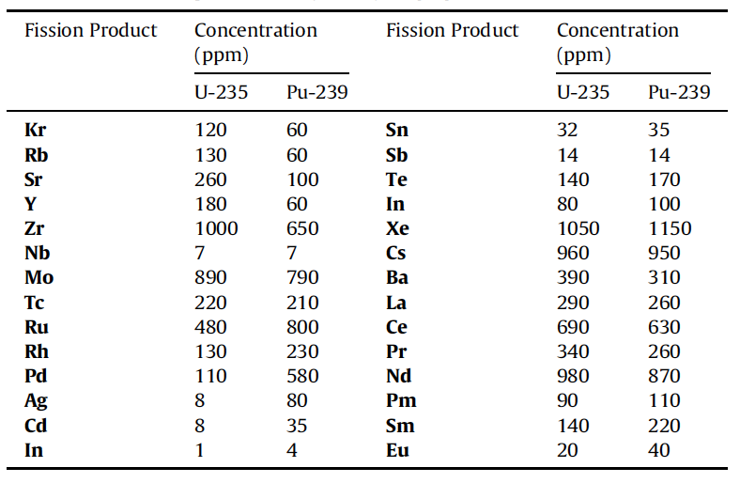
Solid Fission Products
Fission products in oxide fuels can be grouped into 4/5 categories
Fission gases and volatile species
Metallic precipitates
Oxide precipitates
Soluble oxides
LWR fuel vs Pu-containing MOX fuel, we see a higher concentration Ru, Rh, Pd, and a lower concentration of Zr and Mo

Slide 35
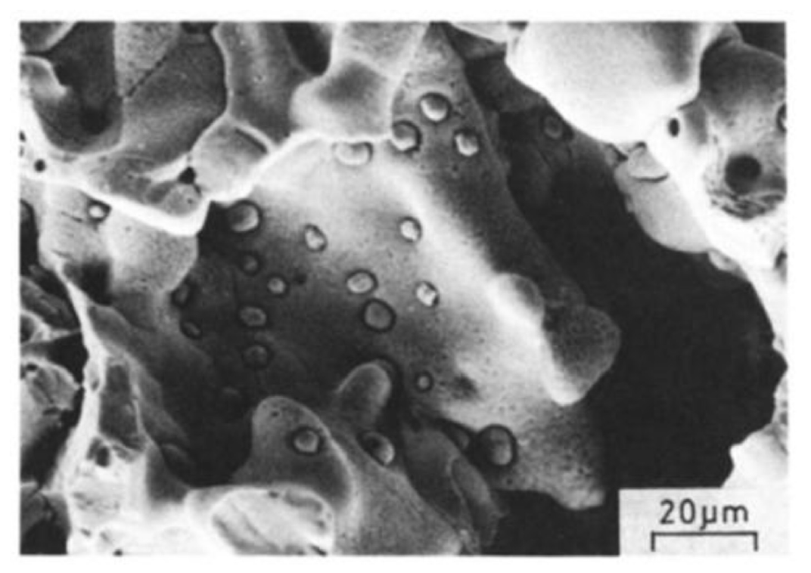
Metallic Inclusions
Mo, Tc, Ru, Rh, and Pd form prominent phases in irradiated nuclear fuels commonly referred to as “white inclusions,” “noble metal,” or “five-metal” precipitates
The particles exist as a solid solution taking on the hexagonal close packed (hcp) structure
The particle size, frequency, and composition exist over a wide range, depending on the burnup and position found within the pellet

Slide 36
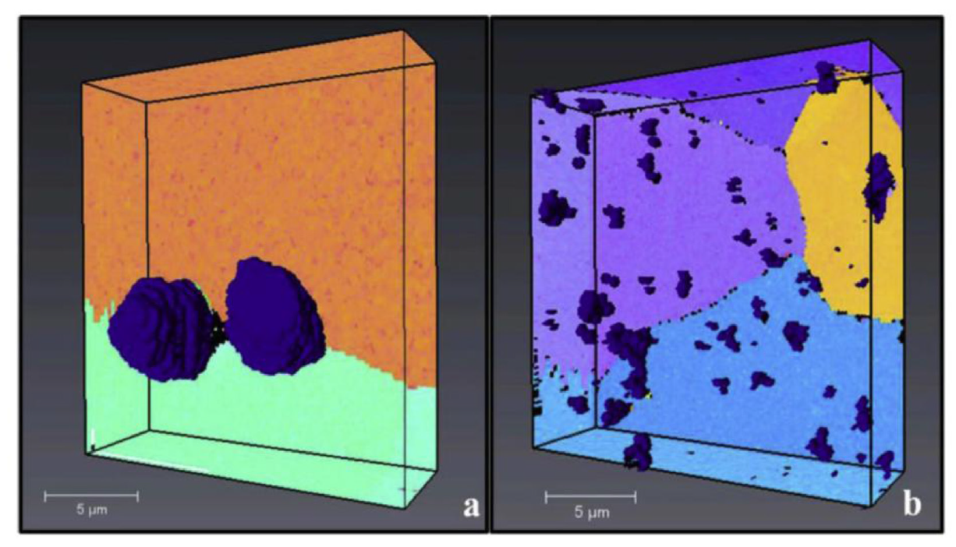
Metallic Inclusions
In the columnar grain region of the fuel, the particles are commonly 5-10 μm in diameter , collecting primarily on the grain boundaries
Particles tend to be much smaller (2 μm and below) in the equiaxed and as-sintered regions, but occur more frequently intragranularly
The particles form as a result of fission product phase agglomeration, as opposed to nucleation and growth process
Columnar Grain Region
Equiaxed Grain Region

Slide 37
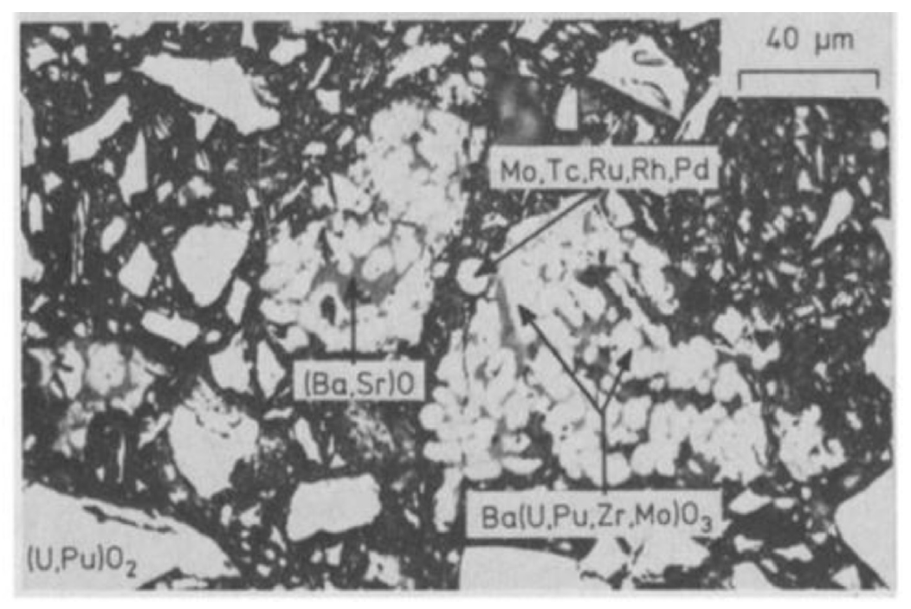
Oxide Phases
Oxides containing Sr, Zr, or the rare earth (RE) elements form solid solutions with either UO2, PuO2, or both at low concentrations
Barium is only soluble to 1.6 at% in MOX fuels and thus precipitates a separate oxide phase at higher concentrations
These oxides, commonly referred to as the “grey phase,” form ABO3 perovskite structures, in which A=(Ba1-x-y, Srx, Csy, x,y ≪1) and B=(U, Pu, Zr, Mo, RE)
The particles are primarily Ba rich, followed by Zr, U, Pu, Mo, Sr, and trace amounts of the remaining products
Due to the sheer number of constituents, the structures are largely unknown
Grey phase is typically found in the equiaxed or outermost regions of the columnar grains commonly intermixed with other constituent oxides

Slide 38
Joint Oxide Gain
The volatiles class of fission products produced during reactor operation are of particular interest to fuel-cladding interactions
Cs, Te, and I all evaporate at low operating temperatures and migrate to the coolest part of the fuel assembly where they react with fuel or cladding constituents
Mo has a tendency to combine with Cs and O to become volatile and migrate toward cooler fuel regions
This has been termed Joint Oxide Gain (JOG)
JOG is an oxide buildup formed on the fuel surface between the pellet and cladding
Primarily Cs2MoO4 or Cs2(U, Pu)O4, the JOG structure is irregular and dense, found in regions where the peak fuel temperature is lowest

Slide 39
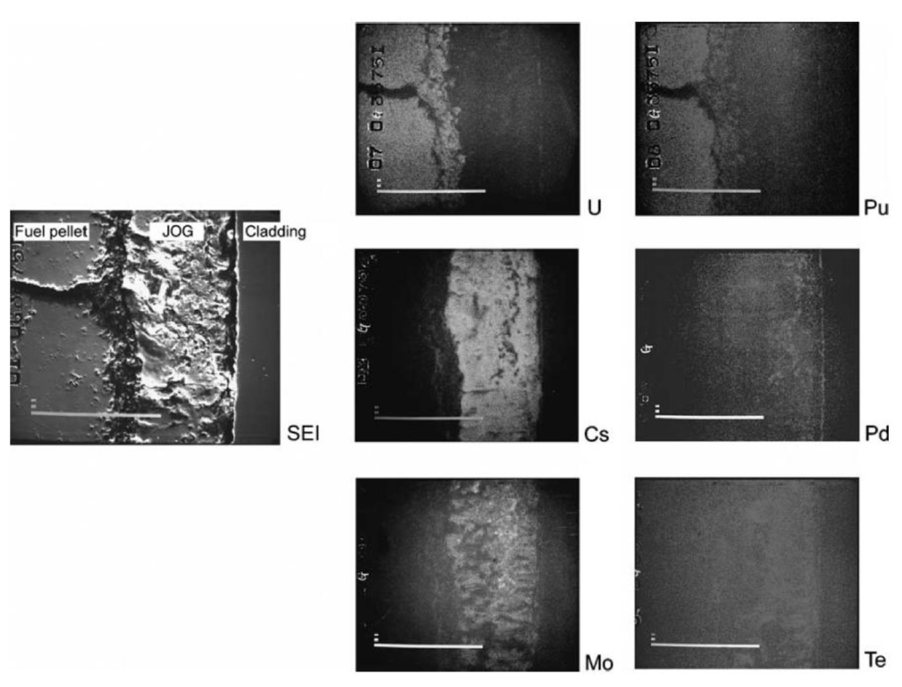
Joint Oxide Gain
The volatile constituents of the JOG structure evaporate from the fuel pellet at high temperatures and condense to become solid at the cooler top or bottom of the fuel assemblies
It is believed that the existence of JOG aids in thermal transport of the fuel, as the oxide structures have higher thermal conductivity than a fuel-cladding gap filled with fission gases

Slide 40
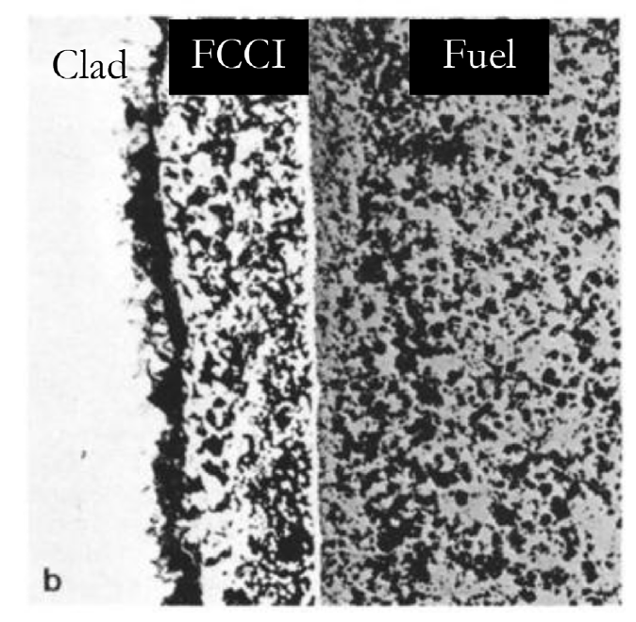
MOX FCCI
The cladding inner surface temperature of LWR MOX fuels do not reach sufficiently high temperatures under normal operating conditions to initiate detrimental oxidation and chemical attack
FCCI manifests itself in three primary modes: matrix attack, intergranular attack, or combined, which demonstrates the properties of both matrix and intergranular attack
Matrix FCCI attack corresponds to the localized oxidation of the cladding material, with primarily oxidation of the Cr in the stainless steel

Slide 41
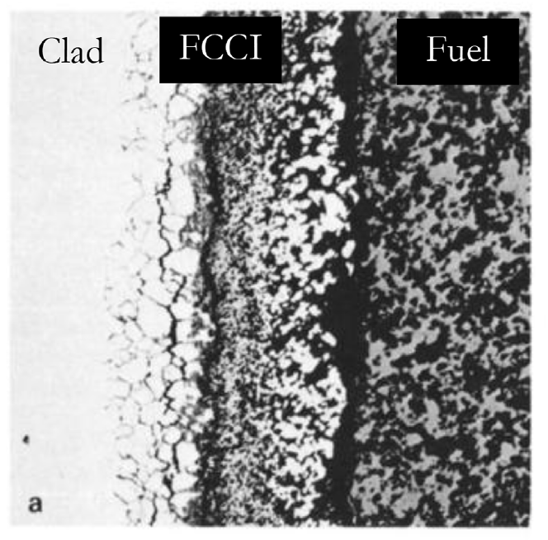
MOX FCCI
Intergranular attack modes occur due to the depletion of Cr in grain boundaries due to the formation of Cr23C6 carbides allowing penetration of corrosive species
Oxygen and volatile fission products (Cs, Te, I, etc.) are the primary culprits of FCCI initiation in oxide fuel systems
In MOX fuels, the oxygen potential of the system is the greatest difference from LWR UO2
The preferential formation of noble metals rather than oxide formers leads to an excess of available oxygen in the system

Slide 42
MOX FCCI
Under normal operation, stainless steel cladding forms a chrome oxide (Cr2O3) layer that acts to protect the cladding from corrosion
Cs is generally unreactive with stainless steel claddings, but reacts with the protective oxide layer to create Cs-chromates (Cs2CrO4 or Cs2Cr2O7) when excess oxygen is present
The decay of the protective oxide layer causes deeper penetration of the FCCI into the cladding
Iodine is primarily bound to Cs in the form of CsI, and can lead to an enhancement in oxidation in hyperstoichiometric fuels
Tellurium is highly active when combined with Cs to create Cs2Te, which can dissolve cladding constituents in the presence of high oxygen potential
The O/M ratio of the fuel before and during irradiation are significant factors, and FCCI can potentially be limited by operating with a hypostoichiometric initial fuel composition

Slide 43
MOX Summary
Phenomena of interest: Pu redistribution, Pu agglomerates, fission product chemistries, JOG formation, and FCCI
O/M ratio is one of the most significant factors in determining the nature of actinide redistribution, fission product precipitate chemistries, and FCCI formation
The effects of fission product precipitates and Pu agglomerates on fuel thermal behavior is highly localized with little discernible influence on the overall fuel burnup behavior

Slide 44
Sodium coolant

Slide 46
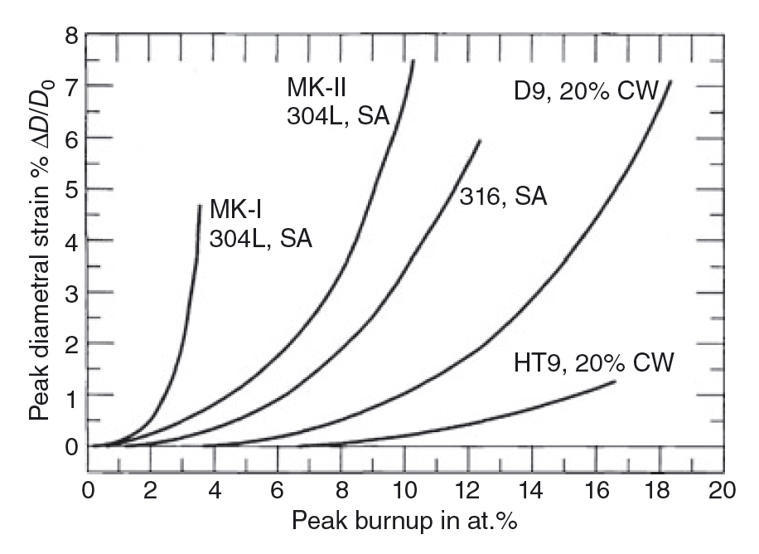
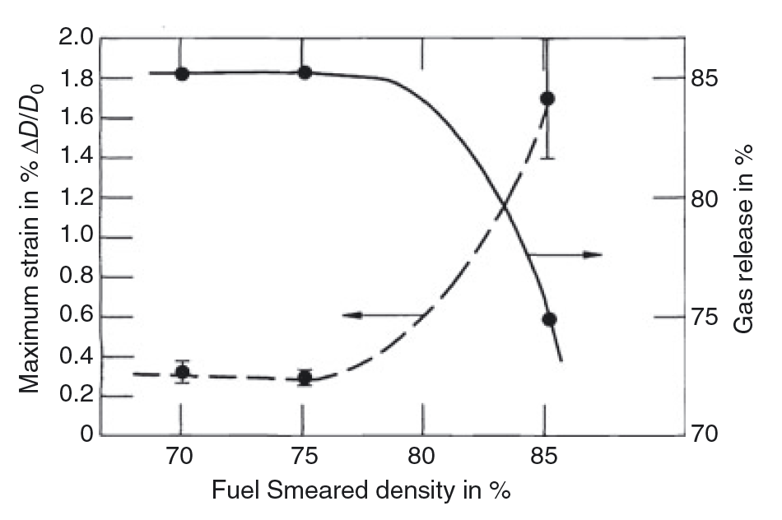
SFR Cladding
HT9 is the current cladding material of choice for SFRs
HT9 is a nonswelling ferritic/martensitic stainless steel
The rate of cladding strain has increased for the initially 85% fuel smeared density elements
12.5% BU

Slide 47
Questions?

